Slide 1
Diamler Trucks Manufacturing Plant Visualization
Rakesh Harish
Ashish Mahendrakar
Manasa Sadananda
Krishna Sreenivas

Slide 2
Outline
Description
About the Data
Tasks
Initial Visualization
Dashboards
Closing Remarks

Slide 3
Project Description
Visualize Real Time Production Metric
Tracking production progress down the line
Key Performance Indicators of Process
Fast Identification of shortages and cries
Overall performance of the plant
Why:
Faster Informed Decision Making
Strategize better, make production lines more efficient.
Know where to focus attention

Slide 4
Tasks
To give an overview of shortages in each shortage type.
Comparison between resolved and unresolved shortages for each type.
Determine which vehicle has item shortage and if it is resolved.
Determine number of cries found by each team along with drilled down view for shift.
Highlighting area that are most affected with effective color coding.
Provide variation in the cries through the day. Drill down view for each department.
Detailed view of cries for each vehicle.

Slide 5
About the data
Item_short data is used to determine the shortage types and no of shortages.
Cries_on_line data is used to determine the number of cries on the line and the department that found the cires.
Definitions data is used to determine the short type codes and inspection teams for cries.

Slide 6
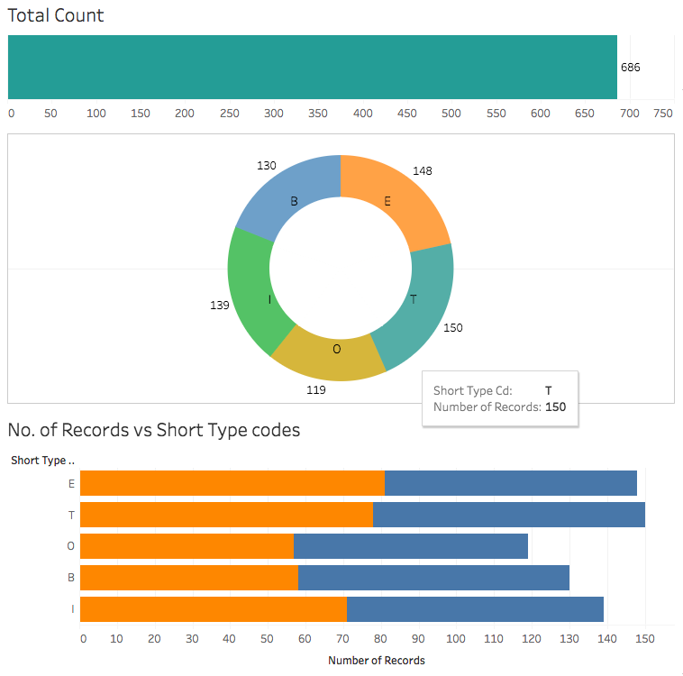
Initial Design
Short types and its status

Slide 7
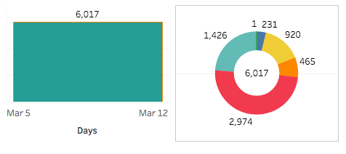
Initial Design (contd..)
No of cries on floor

Slide 8
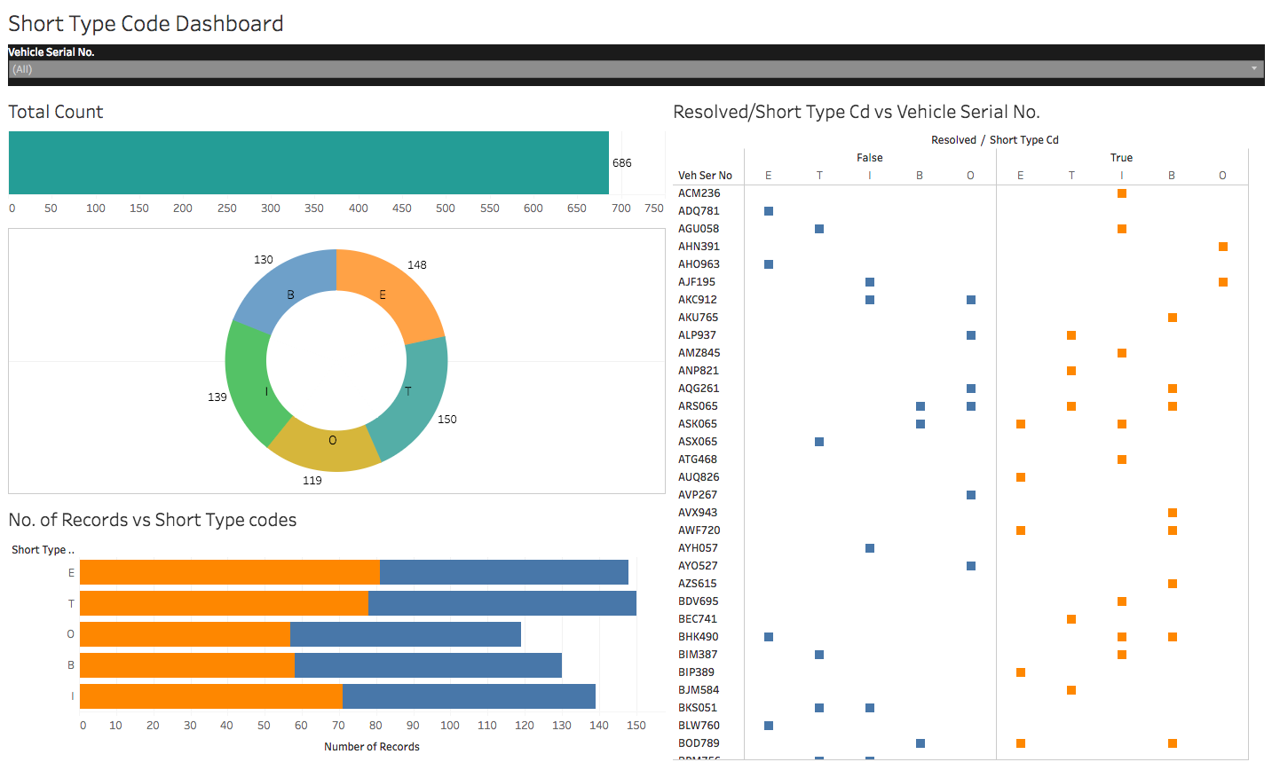
Dashboards

Slide 9
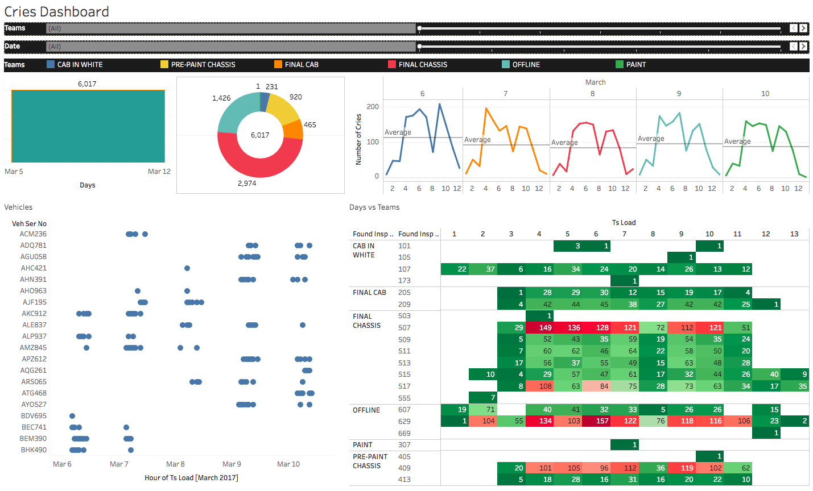
Dashboard (contd..)

Slide 10
Closing Remarks

